Slide 1
Planning for Oxfordshire’s Future
Cllr Ian Hudspeth
Leader, Oxfordshire County Council

Slide 2
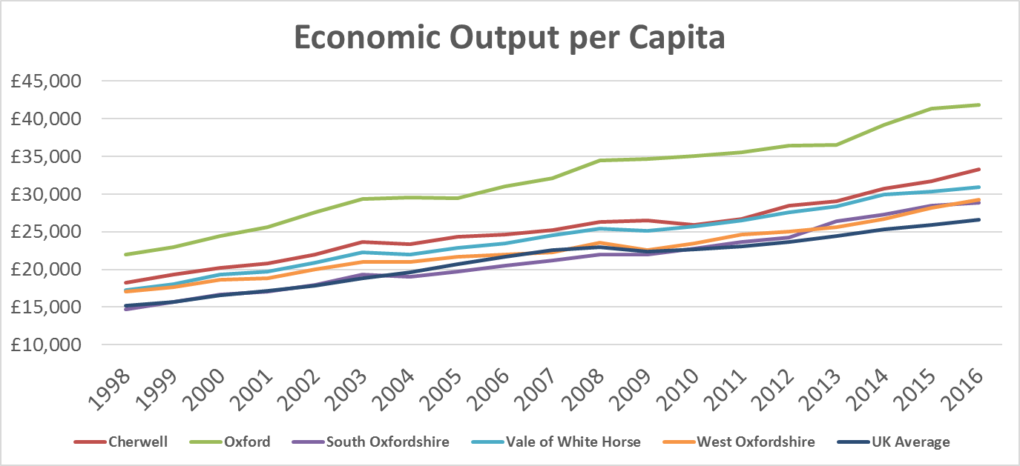
Oxfordshire Context – An Economic Success
Strategic Economic Plan Forecast, net new jobs per year, 2011-2031: 4,280
Actual average net new jobs per year so far, 2011-2018: 4,950

Slide 3
Growth will continue
Oxfordshire’s growth is highly likely to continue to outpace national growth
Government commitment to high growth areas post-Brexit
Innovation engine of two universities, Science Vale, etc
Oxford’s global brand recognition – sought out in China
This brings opportunities for local people but also challenges
Travel and congestion
Affordable and appropriate housing
School places and public services
Quality natural environment and leisure opportunities

Slide 4
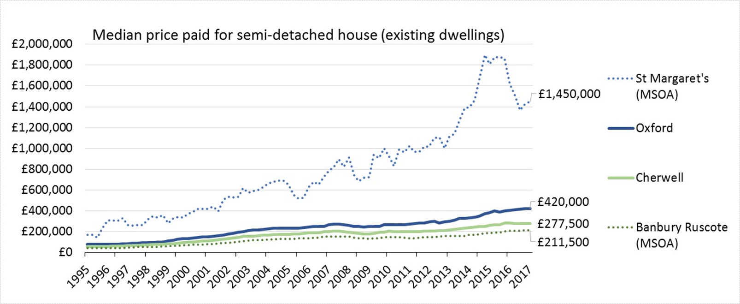
Oxfordshire Context: A Housing Crisis
Centre for Cities again ranked Oxford as the least affordable UK city for housing (2018)
Oxford house prices = 17.3 times annual salaries (up from 16.7 in 2016)

Slide 5
Where We Have Been
Too much unplanned or speculative development and ‘planning by appeal’
Not nearly enough of the infrastructure and services we need to make development and communities work
So a need to reset Oxfordshire’s approach
Our Joint Spatial Plan won’t be more of the same – an integrated approach to development and infrastructure

Slide 6
We Therefore Have a Choice
Not between “no growth”, “low growth”, and “high growth”, but between planned growth, and unplanned growth
Unplanned growth: jobs far from homes, poor connectivity, little to no government infrastructure funding, public services struggling to cope with new population
Planned growth: resolve issues in advance of planning; have a long-term view; schools near homes near jobs; sustainable transport designed in, government funding support to deliver the right outcome

Slide 7
Oxfordshire’s Joint Statutory Spatial Plan
Housing deal agreed by all six councils and the LEP, with government, in March 2018
Real (Funding) outcomes for Oxfordshire
£150m for Infrastructure
£60m for Affordable Housing
£5m Capacity Funding
This is just the start…
Deal includes commitment to an Oxfordshire Joint Statutory Spatial Plan (JSSP) building on current and emerging local plans – using well-understood section 28 powers that include consultation
An Oxfordshire-wide, integrated strategic planning framework to support sustainable growth across the county to 2050, including homes, jobs, and infrastructure.
Plan to be submitted by March 2020, Target for Adoption March 2021

Slide 8
Key Corridors

Slide 9
Potential Strategic Policies in a JSSP
County wide housing requirement figures
Affordable housing requirements
Identification of strategic growth areas
Gypsy, Traveller and boat dwellers, needs and distribution
The spatial dimension of the Local Industrial Strategy
Green Belt strategy and policies
Placemaking and built environment
Health and wellbeing
Natural Capital
Transport strategy
Infrastructure strategy
Energy framework

Slide 10
JSSP: links to other strategies and plans

Slide 11
The Role of the County Council
A Growth Board member,
A key statutory consultee,
The strategic planning authority for Minerals and Waste,
A provider of many essential services to the communities and businesses of Oxfordshire.
The County’s role as Highway/Transport and Education Authority are particularly relevant, meaning it is essential that the County Council supports and provides extensive input to the JSSP preparation process.

Slide 12
Community Involvement
It is a legal requirement of plan preparation that a Statement of Community Involvement is developed.
The objective for the Oxfordshire SCI is to “ensure that plan is shaped by early, proportionate and meaningful engagement between plan makers and communities, local organisations, businesses, infrastructure providers and statutory consultees”.
Draft SCI for consultation is available online (as Appendix 2 to the JSSP report taken to Oxfordshire County Council Cabinet on 18th September)

Slide 13
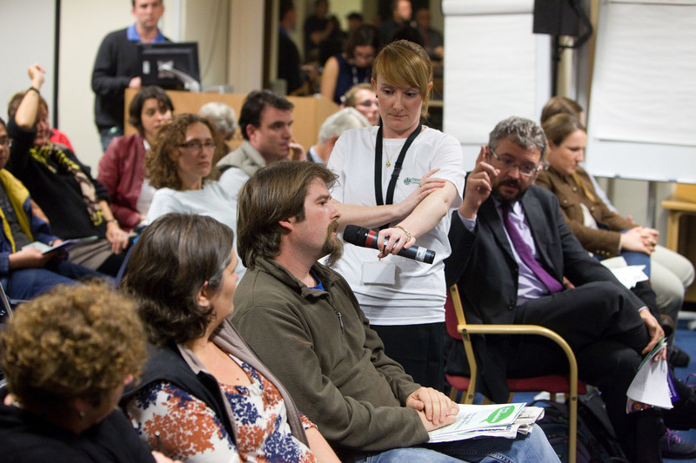
Stakeholders and Communities
JSSP Launch Event this Autumn
statutory consultees, including neighbouring councils;
local service providers and others who may have an interest
other interested groups, businesses, developers, landowners, agents, Town Councils and Parishes, and residents

Slide 14
JSSP Timetable
Early Stakeholder Engagement | November 2018
Consultation on Preferred Strategy Options (Reg. 18) | February/March 2019
Consultation on Proposed Submission Draft Plan (Reg. 19) | October/November 2019
Submission (Reg. 22) | March 2020
Examination (Reg. 24) | September 2020 TBC
Receipt and Publication of Inspector’s Report | December 2020 TBC
Adoption (Reg 26) | March 2021 (subject to examination)

Slide 15
Myths and Facts
“The Growth Board is made up of big business and developers”
There are six voting members of the Growth Board – the Council Leaders
“Local Plans will be replaced by the Oxfordshire JSSP”
The JSSP works with current and emerging local plans to improve joined-up thinking and strategy, it does not ‘over-rule’ local plans, and does not allocate specific sites
“The Growth Deal means 100,000 houses more than planned”
The housing targets agreed in the Growth Deal are broadly the same number assessed as local need by the Oxfordshire SHMA

Slide 16
Questions

Slide 17
Reserve Slides

Slide 18
Oxford to Cambridge Expressway – Corridor Options

Slide 19
SHMA vs “New Methodology”
Government’s national methodology in late 2017 implied a lower number for ‘housing need’, but there are crucial problems in the way of simply adopting this:
It’s based on ‘projections’ – assumptions that the future will simply resemble the past. The ‘past’ in Oxfordshire is low levels of housebuilding, so the projections don’t tell us about need, they tell us about our past failure to meet it, causing the housing crisis we have now
The Government have been clear that their calculation is ‘a floor not a ceiling’, that areas with high economic growth may want to include that in a higher local calculation, and that areas which do ‘the bare minimum’ are unlikely to get government funding for infrastructure and affordable housing
We therefore stand by, and are planning for, the SHMA figure – which has secured hundreds of millions in Government funding

Slide 20
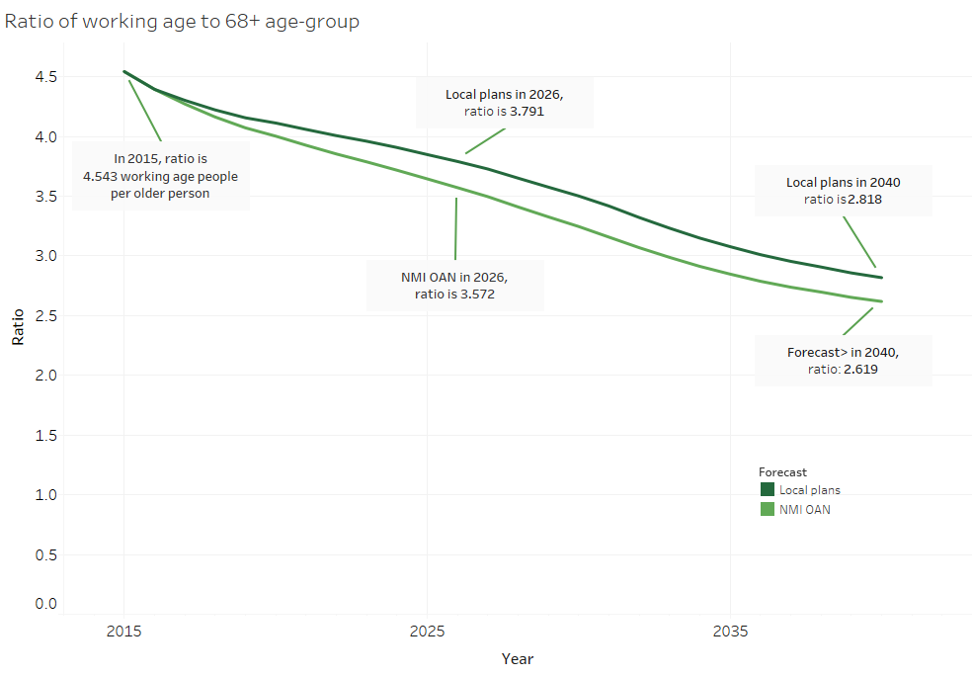
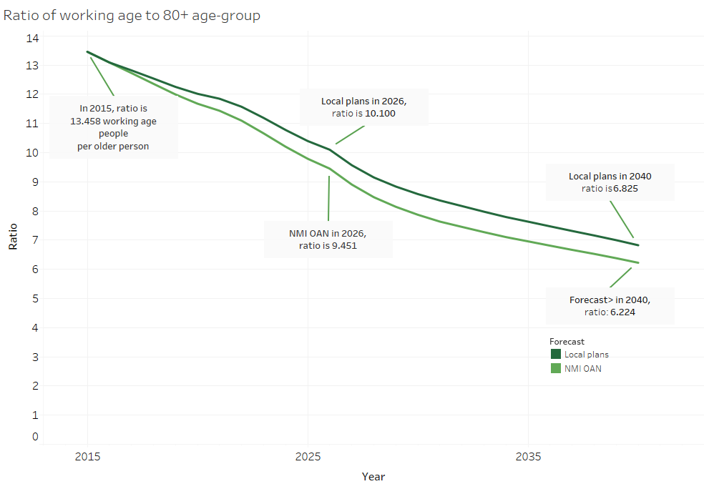
The Health and Care Workforce Challenge
On both housebuilding trajectories there is a serious risk relating to the falling proportion of working-age to pension-age and older people

